Slide 1
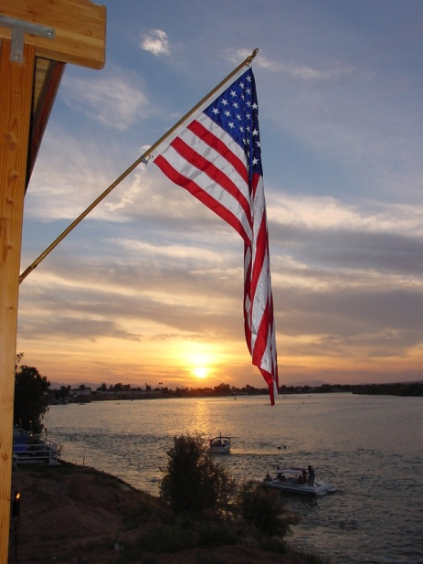
Welcome
Welcome!

Slide 2
Why we are here today
TO HELP VETERANS IN YOUR COMMUNITY
  Education:
    Information and resources about Veteran benefits and services.
  Collaboration:
    Work together to plan a Veterans outreach event.
  Partnership:
    Relationship between VA and the Community to help Veterans.

Slide 3

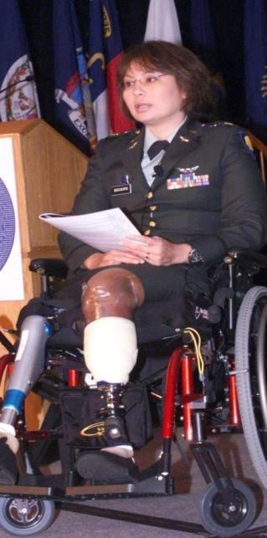
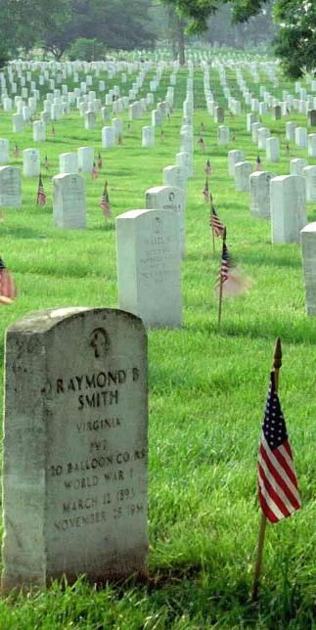
Differences in VHA, VBA, NCA and State
TO HELP VETERANS IN YOUR COMMUNITY
  Partnership:
    Create(or expand) a partnership between the VA and the Community.
  Education:
    Gather VA information and resources so you may help a Veteran receive his/her benefits.
  Collaboration:
    VA and the Community work together to hold an outreach event.
Veterans Health Administration (VHA)
Veterans Benefits Administration (VBA)
National Cemetery Administration (NCA)

Slide 4
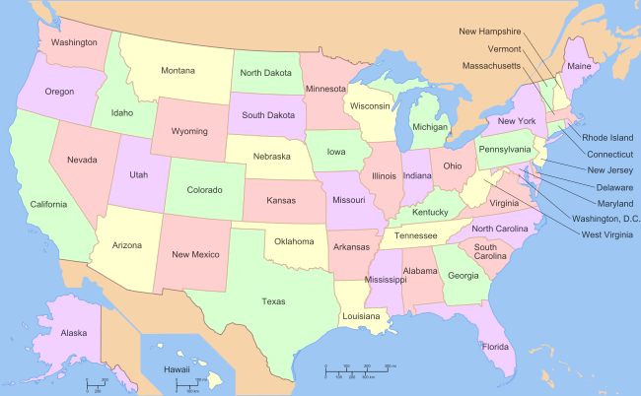
Differences in VHA, VBA, NCA and State
Each state has their own
Veterans Affairs Office

Slide 5
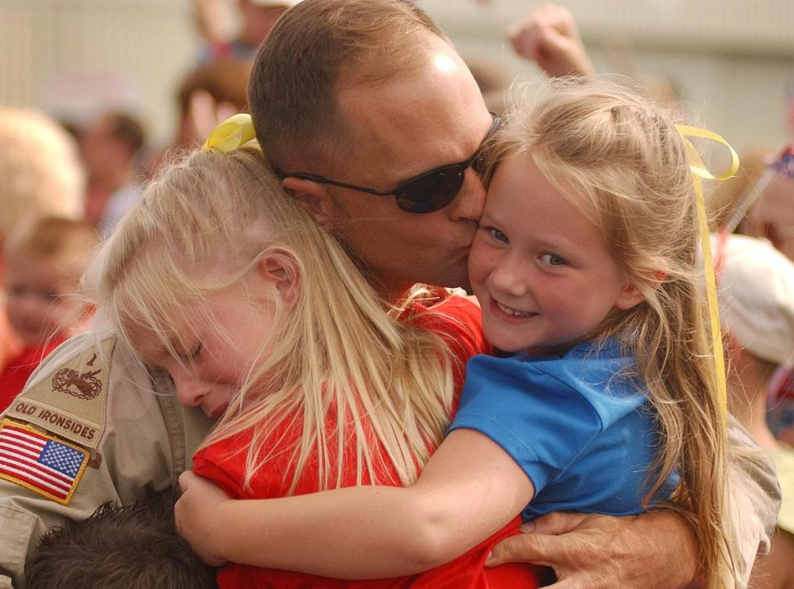
“As we express our gratitude, we must never forget that the highest appreciation is not to utter words, but to live by them.”
JFK

Slide 6

Veterans Resources
and Benefits Workshop
Kodiak, Alaska
April 19, 2012
Mr. Alex Spector, Director
Mr. Greg Puckett, Associate Director
Dr. Cynthia Joe, Chief of Staff
Ms. Linda Boyle, R.N., Associate Director
for Nursing and Patient Services

Slide 7
Department of Veteran Affairs
3 Administrations
Veterans
Health Administration
(VHA)
Veterans
Benefit Administration
(VBA)
National Cemetery Administration
(NCA)
Alex Spector, Director
Alaska VA Healthcare System
Anchorage, AK
Joyce Cange, Acting Director
Anchorage Regional Office (remotely managed from Salt Lake City, UT)
Chad Pomelow
VBA Service Center Manager
Anchorage, AK
Aaron Pugh, Acting
Vocational Rehab. & Employment
Ft. Harrison, MT
Virginia Walker, Director
Fort Richardson
and Sitka, AK

Slide 8
Other Department of Veterans Affairs Services in Alaska
Vet Centers
Report to Regional Director based in Denver, CO
  Anchorage – Bob Erwin, Teamleader
  Fairbanks – Heidi Mattson, Teamleader
  Kenai Peninsula – Bob Erwin, Teamleader
  Kim Haviland, LCSW
  Wasilla – Patrick Summers, Teamleader

Slide 9
Alaska VHA Demographics
FY11 Veteran Population 77,351
(Source www.va.gov/vetdata)
FY11
Overall Enrollees 30,022
Total Unique Patients 16,595
VA Outpatient Clinic Visits 170,281
38.8% Veteran Population enrolled – Market Penetration

Slide 10
ALASKA VA WORKLOAD

Slide 11
Alaska Veteran Population Distribution
By Area of the State | FY11 Veteran Population | % of Vet Pop | FY11 Enrollees for Alaska VA Healthcare | % of Vet Pop in Area Enrolled
Anchorage | 31,190 | 40.3% | 13,922 | 45%
Fairbanks | 13,034 | 17% | 4,534 | 35%
Mat-Su | 10,532 | 13.6% | 4,433 | 42%
Southeast | 7,987 | 10.3% | 1,158 | 14.5%
Kenai | 6,580 | 8.5% | 2,421 | 37%
West/SW Alaska | 2,846 | 3.7% | 526 | 18.5%
Northern Alaska | 2,576 | 3.3% | 375 | 14.5%
Kodiak | 1,304 | 1.7% | 329 | 25%
Valdez/Cordova | 1,302 | 1.7% | 383 | 29%

Slide 12
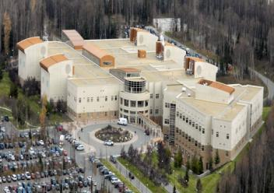

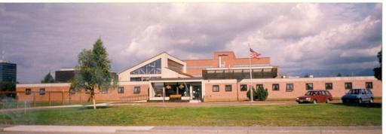
Sites of VA Care
VA/DOD Joint Venture Hospital
Elmendorf Air Force Base
Anchorage VA Outpatient Clinic - Muldoon Clinic
Domiciliary Care for Homeless Veterans

Slide 13
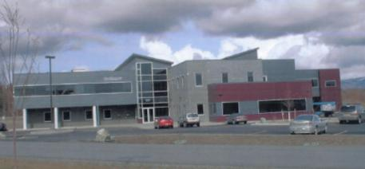
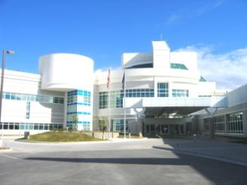

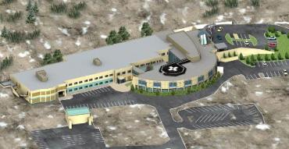
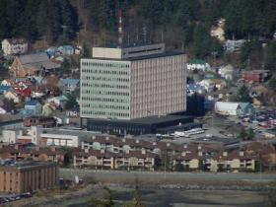
VA Sites of Care, cont.
Mat-Su VA Community Based Outpatient Clinic
Fairbanks VA Community Based Outpatient Clinic
Homer VA Outreach Clinic
Juneau VA Outreach Clinic

Slide 14

ELIGIBILITY
VHA Health Eligibility Center Health Benefits Website
http://www.va.gov/healthbenefits/

Slide 15
Definition of Veteran for VA Purposes
Veteran is a person who:
  Served in the active military
  Discharged or released under conditions other than dishonorable.
Former or current Reservists if they served for the full period for which they were called (excludes training purposes).
Former or current National Guard members if activated/mobilized by a Federal order.

Slide 16
Recent Combat Veterans
OIF/OED/OND Combat Veterans *
5 Years of Free Medical Care for conditions possibly related to service
Extended Future Eligibility
Dental for First 120 Days After Discharge
*Operation Iraqi Freedom
*Operation Enduring Freedom
*Operation New Dawn

Slide 17
Enrollment
Application for Health Care is VA Form 10-10EZ
  Obtain at any VA facility or by calling 1-877-222-VETS, or submit on-line at www.1010ez.med.va.gov
  Mail or take application to local VA Medical Center
    In Alaska mail to: Alaska VA Healthcare System Attn: Eligibility – 136A 1201 N. Muldoon Road Anchorage, AK 99504 or Fax 257-6784
  Enrollment letter sent to veterans notifying of enrollment
  Annual enrollment system
  Contact local VA to schedule an appointment

Slide 18
Income Thresholds
Certain Veterans are required to complete a financial assessment (i.e. Means Test) annually to determine copayment status.
Uses Veteran’s household income, including spouse and dependents, prior year income and assets for financial assessments.
Updated each calendar year based on the income limits established by U.S. Department of Housing and Urban Development (HUD).
    VA Means Test Threshold
    VA GMT (Geographically adjusted) Income Threshold
http://www.va.gov/healthbenefits/cost/income_thresholds.asp

Slide 19
Copayment Charges for Certain Veterans
Veterans may be responsible for copayments for certain types of services provided by the VA. Copayment amounts vary depending on type of service rendered and financial assessment, as applicable. Such copayments include:
  Outpatient Copayments
  Inpatient Copayments
  Medication Copayments
  Extended Care Services Copayments (e.g. community living center or nursing homes, adult day healthcare, geriatric evaluations, etc.)
No copayments and no insurance billing for treatment of SC conditions.

Slide 20
Medication Copayments
$8 or $9 for 30 Day Supply
Service Connected Less Than 50%
Veterans With Income Above:
  Single $12,256
  Married $16,051
    * $2,093 for Additional Dependents

Slide 21
Medical Care Copayments
Care is Free or Low Cost
$15 for Primary Care Visits*
$50 for Specialty Service at VA*
$8 or $9 for 30 Day Supply of Medication
*Includes all testing that day.

Slide 22
VA Comprehensive Medical Benefits Package
Benefits include:
  Preventive Care Services
  Inpatient and Outpatient Diagnostic and Treatment Services
  Prescription Services
    Prescribed by VA Provider or community provider that is seeing a Veteran under a VA authorized period of care
  Prosthetic and Rehabilitative Devices
    Includes Durable Medical Equipment
Once enrolled, Veterans have access to the complete Medical Benefits Package

Slide 23
Medical Benefits Package
Limited Benefits
    Ambulance Service
    Travel
    Eyeglasses and Hearing Aids
    Non-VA Care (purchased care from the community)
    Prosthetics, Durable Medical Equipment and Rehabilitative Devices
    Dental Care
    VA Foreign Medical Program

Slide 24
VA Comprehensive Medical Benefits Package
Benefits NOT included:
  Abortion or abortion counseling
  In vitro fertilization
  Drugs, biologicals, and medical devices not approved by the Food and Drug Administration unless used under approved clinical research trials.
  Gender alterations
  Hospital and outpatient care for a Veteran who is either a patient or inmate in an institution of another government agency if that agency has a duty to give the care or services.
  Membership in spas or health clubs

Slide 25
Beneficiary Travel Eligibility
Travel eligible veterans are those:
  Veterans rated 30% or more SC for travel relating to any condition;
  Veterans rated less than 30% for travel relating to their SC condition;
  Veterans receiving VA pension benefits for all conditions;
  Veterans with annual income below the maximum applicable annual rate of pension for all conditions ($11,830 for a single Veteran); or
  Veterans traveling in relation to a Compensation and Pension (C&P) Examination
VA pays for plane tickets for Veterans off the road system and those outside South Central Alaska.
Mileage is reimbursed at the rate of 41 ½ cents per mile to the nearest VA for those on the road system .

Slide 26
Veterans Transportation Service (VTS) Grant
Eliminate transportation as a barrier to help Veterans get healthcare.
Gives VA ability to purchase air fare for Veterans who otherwise would not be eligible for VA Travel under current authority.
Contact Kathy Johnson, Beneficiary Travel Manager, at 907-257-4948 or toll free 1-888-353-7574, ext. 4948.

Slide 27
VA PURCHASED CARE
Alaska Vendor/Partner Guidebook
http://www.alaska.va.gov/About/Vendors.asp

Slide 28
Alaska VA Healthcare System Delivery of Care
Direct Delivery of Care – Alaska VA Outpatient Facilities
  Anchorage
  Fairbanks
  Kenai/Homer
  Mat-Su
  Juneau
Referral to Federal Facilities within Alaska
  VA/DoD Joint Venture Hospital – EAFB
  Bassett Army Community Hospital (BACH)
Purchase of care from local facilities in Alaska
  Hospitals and offices throughout Alaska
  Inpatient care: preferred provider contract pending
Referral to Federal Facilities outside Alaska
  VA Puget Sound Health Care System
  Other VA Medical Centers
Notes:
38 CFR, Chapter 17.52 states that hospital and medical care may be provided in non-VA facilities only when VA or other government facilities are not capable of furnishing hospital care or medical services because of geographic inaccessibility or are not capable of furnishing the care or services required.
If we are not able to obtain care from federal facilities within time frame specified for the medical urgency, the care is purchased to meet the medical urgency.
In FY 06, the Alaska VA purchased $36,418,859 for care of veterans within Alaska; that is 38% of our overall appropriated funding or 51% of our Medical Service funding received.
Referrals to Lower 48 VA facilities for FY 06, approximately 915 inpatient and outpatient with an estimated cost of $7,123,200 if purchased in Alaska.
Some veterans choose to stay in Alaska vs. going to the lower 48 federal facility and will use private insurance, Tricare, Medicare, or Medicaid to receive their medical care.

Slide 29
Reasons Why VA Purchases Care
Ensure complete continuum of quality care when VA does not have internal resources. available
  Unable to access VA health care facilities.
  Demand exceeds VA health care facility capacity.
  Need for diagnostic support services for VA clinicians.
  Need for scarce specialty resources (e.g., obstetrics, hyperbaric, burn care, oncology) and/or when VA resources are not available due to constraints (e.g. staffing, space).
  Satisfying patient wait-time requirements.
  Ensure cost-effectiveness for VA (whereby outside procurement vs. maintaining and operating like services in VA facilities and/or infrequent use is more appropriate).

Slide 30
Augmentation of VA in-house capabilities and capacity
Purchased Care is | Purchased Care is Not
Supplement to VA health care | Substitute or replacement for VA health care
Secondary care when service is not available within the VA - Limitations to extend care may be authorized | All health care services at any VA facility
Health care delivery system - Requires matching of claims to individual authorizations for care | Insurance or a health plan - No standard set of benefits
Flexible, can adapt Medicare payment rules for certain types of claims | Medicare or TRICARE

Slide 31
Authorities Governing the Fee Program
38 USC 1703: The authority to pay for preauthorized inpatient and outpatient emergency, routine, and diagnostic medical care for certain veterans.
38 USC 1728: The authority to pay for emergency care provided to service-connected veterans that was not preauthorized.
38 USC 1725: The authority to pay for emergency Non-VA care provided to non-service connected veterans enrolled in VA health care.
38 USC 8153: Provides the authority for a VA facility to enter into a contract or other form of agreement with Non-VA health care entities to secure health care services that are either unavailable or not cost-effective at the VA facility.
REGULATION SPECIFIC TO WOMEN VETERANS
Women veterans are eligible for preauthorized hospital care for any condition under the Code of Federal Regulations (38 CFR) 17.52(a)(4).

Slide 32
Overall Process
Initial decision on health care needs
Determination of need for Non-VA vs VA
Consult prepared
Approved (Pre-Authorized) by delegated official
Administrative eligibility verified
Non-VA Staff prepares authorization
Patient appointment in non-VA setting
Return of clinical information
Health care claim paid

Slide 33
Emergency Care
  When a Veteran seeks emergency care at a non-VA facility, the non-VA provider should contact the closest VA facility promptly (within 72 hours):
    Notify VA of Veteran treatment/admission
    Verify eligibility of Veteran for reimbursement of claim and identify the VA of jurisdiction to submit claims.
    Obtain instructions for transfer of VA patient to VA.

Slide 34
Operation Enduring Freedom/ Operation Iraqi Freedom/Operation New Dawn
(OEF/OIF/OND)
Alaska VA Serving
Returning Service Men and Women

Slide 35
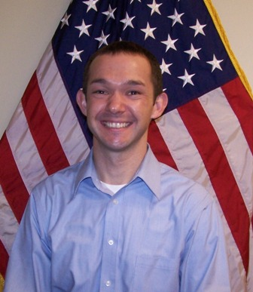
OEF/OIF PROGRAM MANAGER
Troy Townsend, LCSW
Social & Behavioral Health Service
257-7432
Oversees all the seamless transition activities and the coordination of care and services for veterans and family members treated.

Slide 36
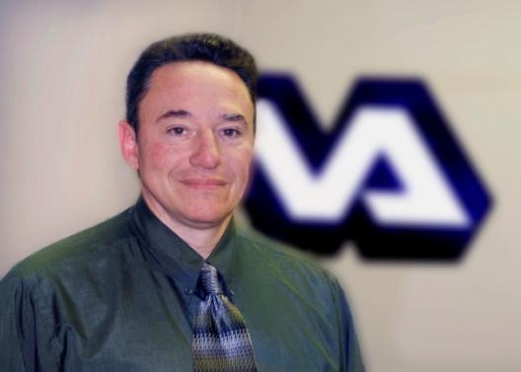
OEF/OIF
TRANSITION PATIENT ADVOCATE
Michael Pascale
Social & Behavioral Health Service
257-7435
“Barrier Buster”
Primary Point of Contact to assist transitioning OEF/OIF/OND Veterans and their families.

Slide 37
OEF/OIF/OND Veterans Access VA Care (September 11, 2001 – March 2012)
Registered- 6,531
Empanelled to Primary Care – 2,799 (43%)
  Anchorage- 1,824
  Fairbanks- 647
  Kenai- 80
  Juneau - 40
  Mat-Su- 208
New Mental Health (MH) 1125 (40%) of empanelled
  New Substance Abuse - 107 (9.5%) of MH patients
  Combined PTSD/Substance Abuse - 684 (61%)
Traumatic Brain Injury
  Approximately 360 (13%) of Veterans empanelled in Primary Care screened positive.

Slide 38





Slide 39

WOMEN VETERANS

Slide 40
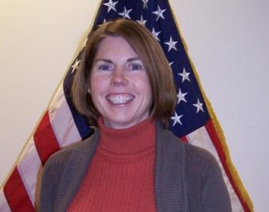
Elizabeth Baltensperger, LCSW
Women Veterans Program Manager
2012 Women Veterans Events
March - Anchorage & Fairbanks Town Hall
May 12 – Women Veterans Retreat, Anchorage
November – Annual Women Veterans Recognition Ceremony
All provide opportunities for outreach and to gain input from the public regarding services for women Veterans.
Growth from previous years-Unique Patients Served
FY08- 4%, FY09- 6%, FY10-6%, FY11-10%
We are serving 22% of the Female Veterans in Alaska.

Slide 41

Contact Sally Kneeland, LCSW, toll free at 1-888-353-7574, ext. 4908

Slide 42

Eliminating Homelessness

Slide 43
Homeless Veterans Services
Outreach
Domiciliary Care for Homeless Veterans Program (DCHV)
Compensated Work Therapy
Compensated Work Therapy Transitional Residence
HUD/VA Supported Housing
Grant Per Diem Program
Compensated Work Therapy Supported Employment
Homeless Veterans Supported Employment Program
Health Care for Re-entry Veterans/Veterans Justice Outreach
Supportive Services for Veteran Families Program
Notes:
Outreach –More details on next slide
Domiciliary – Located in mid- town. 50 beds. Undergoing Seismic project. Committee will tour in afternoon. Census: 24
VI – Vocational and employment assessments. Have Incentive Therapy and Compensated Work Therapy. Agreements with businesses in the community. Census: 22
PRRTP – 3 four-plexes in community. Recent $1.5 million project to upgrade the housing. Census: 5
HUD/VASH – Section 8. Census: 18
GRANT Per Deim – Awaiting contractor to finish work for final inspection to start program

Slide 44
Eliminate Homelessness
Current HUD Point-In-Time count of Chronic Homeless Veterans in Alaska, as of January 27, 2012, is 265, down 49.9% over the past two years.

Slide 45
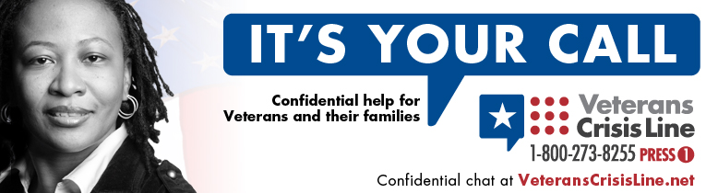
Veterans Crisis Line
Alaska VA Suicide Prevention Coordinator
Sue May, LCSW, toll free at 1-888-353-7574, ext. 4846

Slide 46
RURAL HEALTH CARE

Slide 47
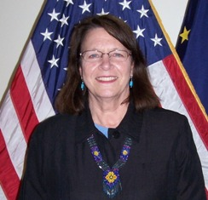
RURAL HEALTH CARE
VA/Tribal Consultation Process
Alaska Native Health Board has established a working group to work with VA.
Goal: MOUs with Native Tribal Health Corporations to provide rural Veterans Healthcare.
Susan Yeager
Rural Health Program Coordinator

Slide 48

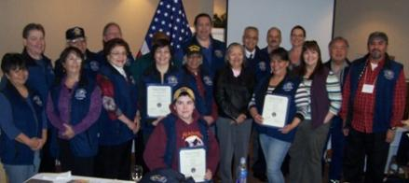
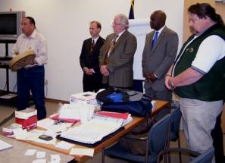
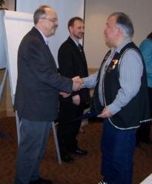
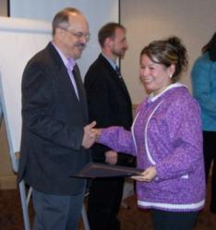
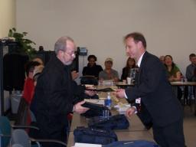
Approximately 60 trained to date.
Point of Contact for Veterans in their community
Traveled from various locations throughout Alaska on VA Invitational Orders
Next training session September 25 – 27, 2012.

Slide 49

TECHNOLOGY
Alaska VA POC:
Victoria Green at 317-8620
or Toll Free at 1-888-353-7574, ext. 7497
Tele-Mental Health Initiatives

Slide 51
Questions
Marcia Hoffman-DeVoe
Public Affairs Officer
Alaska VA Healthcare System
1-888-353-7574, ext. 5490
1-907-257-5490
Marcia.hoffman-devoe@va.gov
www.va.gov or www.alaska.va.gov
Join us on Facebook
Facebook.com/VAAlaska

Slide 52
BREAK

